Slide 1

Chatbots
Notes:
GnG

Slide 2

What is it?
Le Chat – bot!

Slide 3
No, really, what is it?
“A chatbot is a service, powered by rules and sometimes artificial intelligence, that you interact with via a chat interface. The service could be any number of things, ranging from functional to fun, and it could live in any major chat product (Facebook Messenger, Slack, Telegram, Text Messages, etc.)”
medium.com
“A chatbot is an artificially intelligent software program that uses natural language processing to simulate intelligent conversation with end users via auditory or textual methods.”
pandorabots.com
Notes:
I like these definitions because they both point out different things related to chatbots.
Essentially, chatbots can do a variety of things. In Asia, people use the WeChat app to do things with Chatbots, like schedule doctor's appointments, shop for shoes, play games or the lottery and send money to friends.

Slide 4
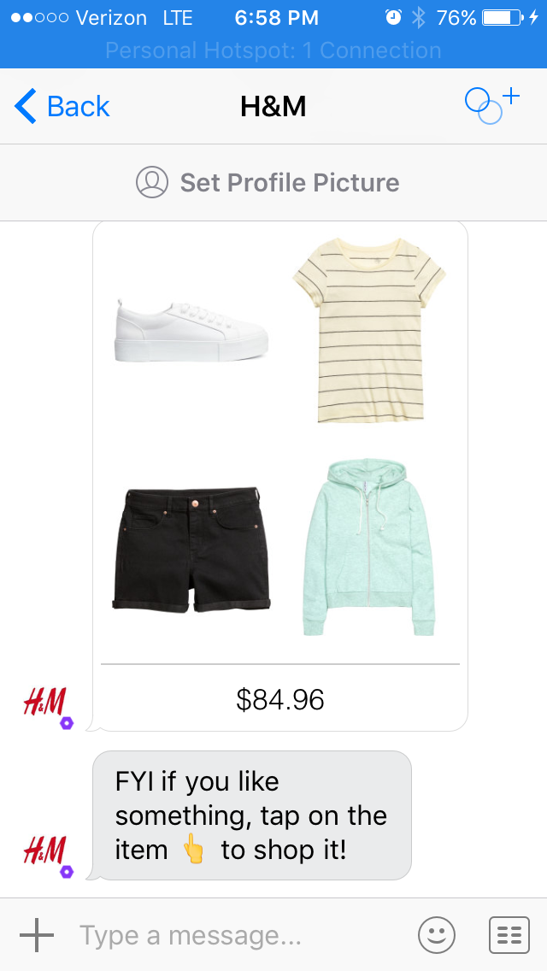
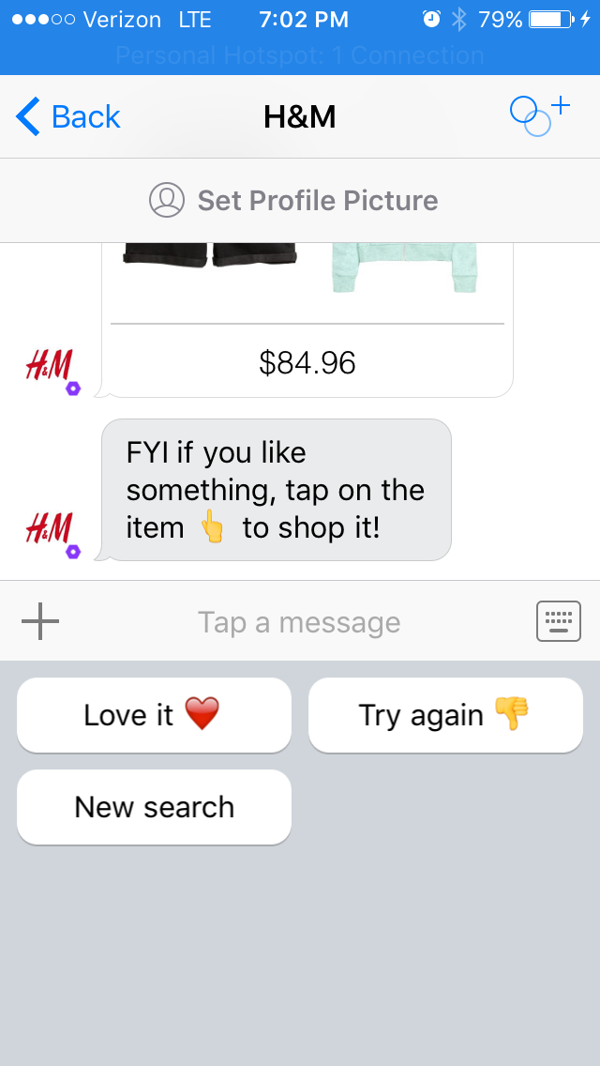
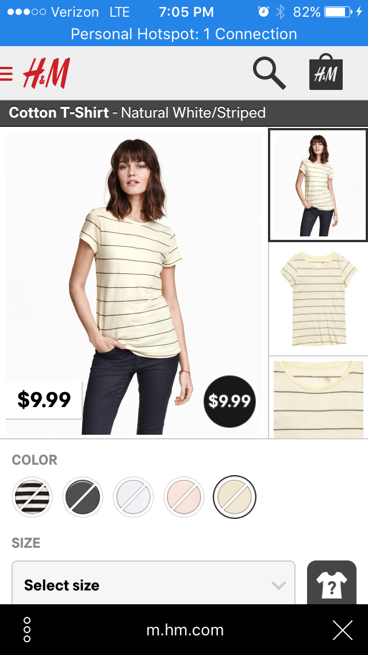
Kik – H & M Bot
Notes:
- The messaging platform Kik has a variety of chatbots.
This is the H & M clothing store chatbot
After entering in some preliminary information about my tasks, it then starts to show me outfits.
The image on the left reflects one outfit that it selected.
The middle image, showing the chat interface – I can either type a message or click on one of the options shown; the responses all aid the bot in gathering more information about my style (although I am not sure if that is true for the new search button)
The final image on the right shows what happens if I click on an item – I got to the H& M store where I can buy the item.
Keys: I am not in an H & M app, I have more personalized information than what I might be able to otherwise obtain

Slide 5
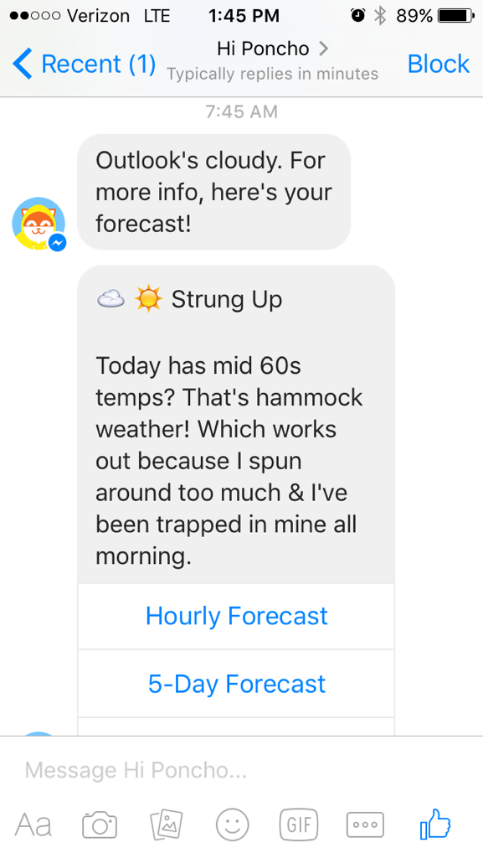
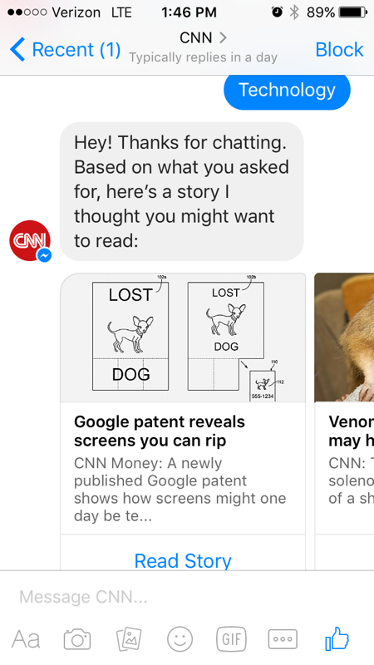
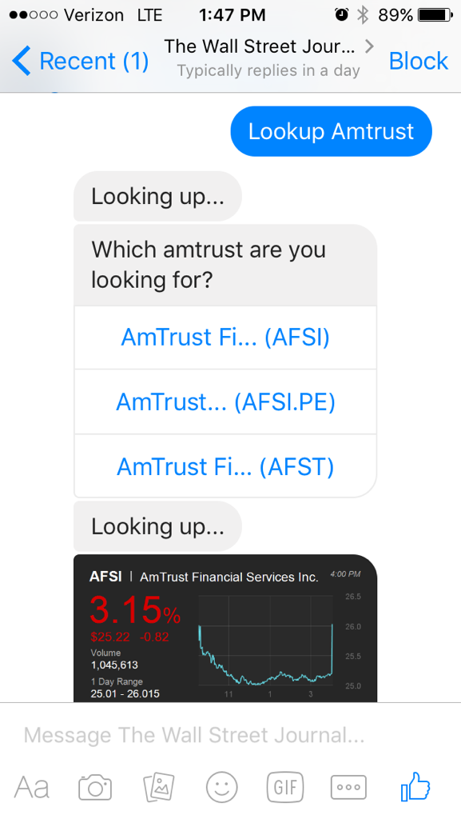
Facebook – CNN, Poncho, WSJ
Notes:
These are all Facebook chatbots that were revealed on April 12.
The one on the left is Poncho – the “weather cat” – he sends me a customized update each morning at 7:45am.
The one in the middle is CNN. I typed technology and multiple stores appeared.
The one on the right is the WSJ. I typed in the name of my old employer, and it asked first which company, and then sent a stock quote.

Slide 6
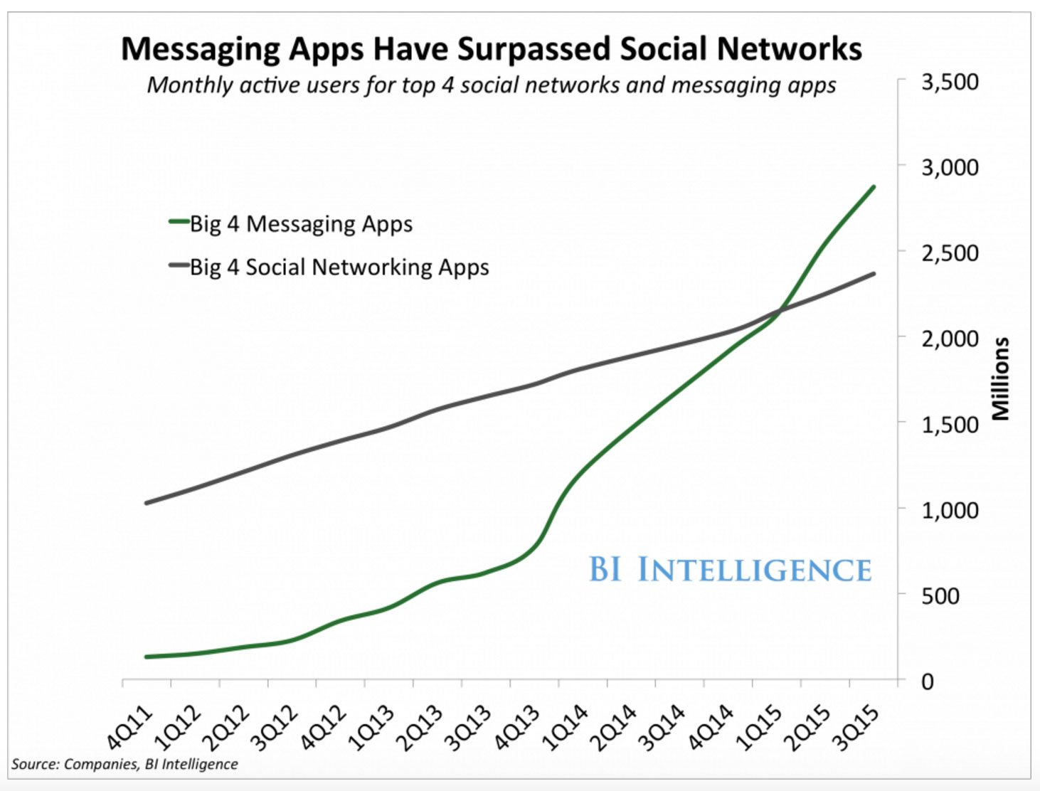
Messaging versus Social Networks
Notes:
- This is one of those business school like slides, with the “use case”.
- It shows graphically how messaging has surpassed social networks in terms of monthly active users.
- Messaging app is green line, social media is gray line.

Slide 7
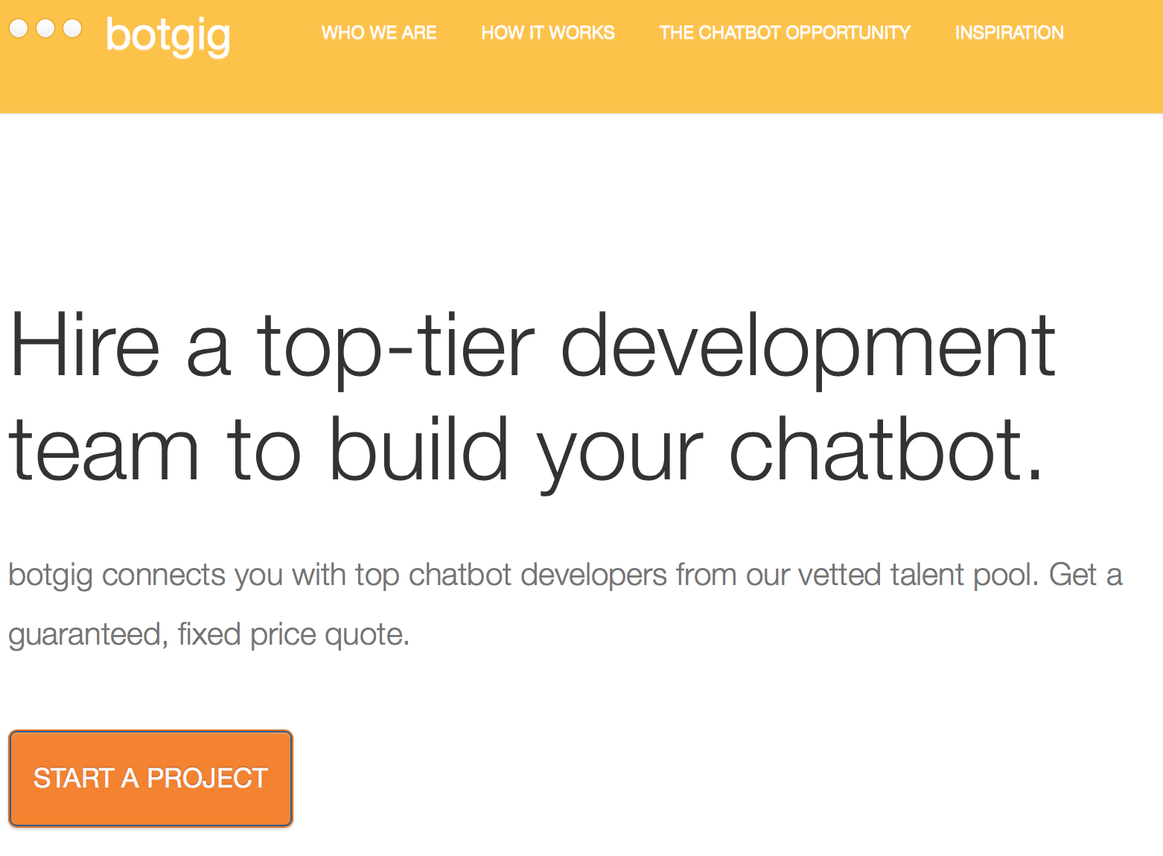
Better yet, build it yourself!

Slide 8
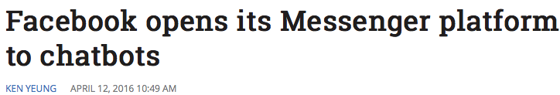
Building a Facebook Bot
https://developers.facebook.com/docs/messenger-platform/quickstart
Notes:
On April 12, 2016, Facebook opened its Messenger platform to chatbots.
Facebook has easy to understand directions complete with screenshots on how to set up a chatbot on Facebook using Messenger.
The directions do not show you all of those other necessary steps…

Slide 9
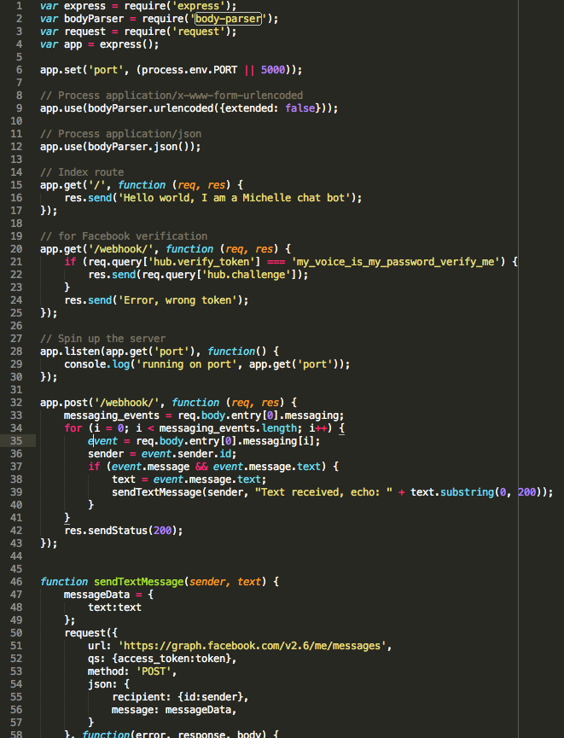
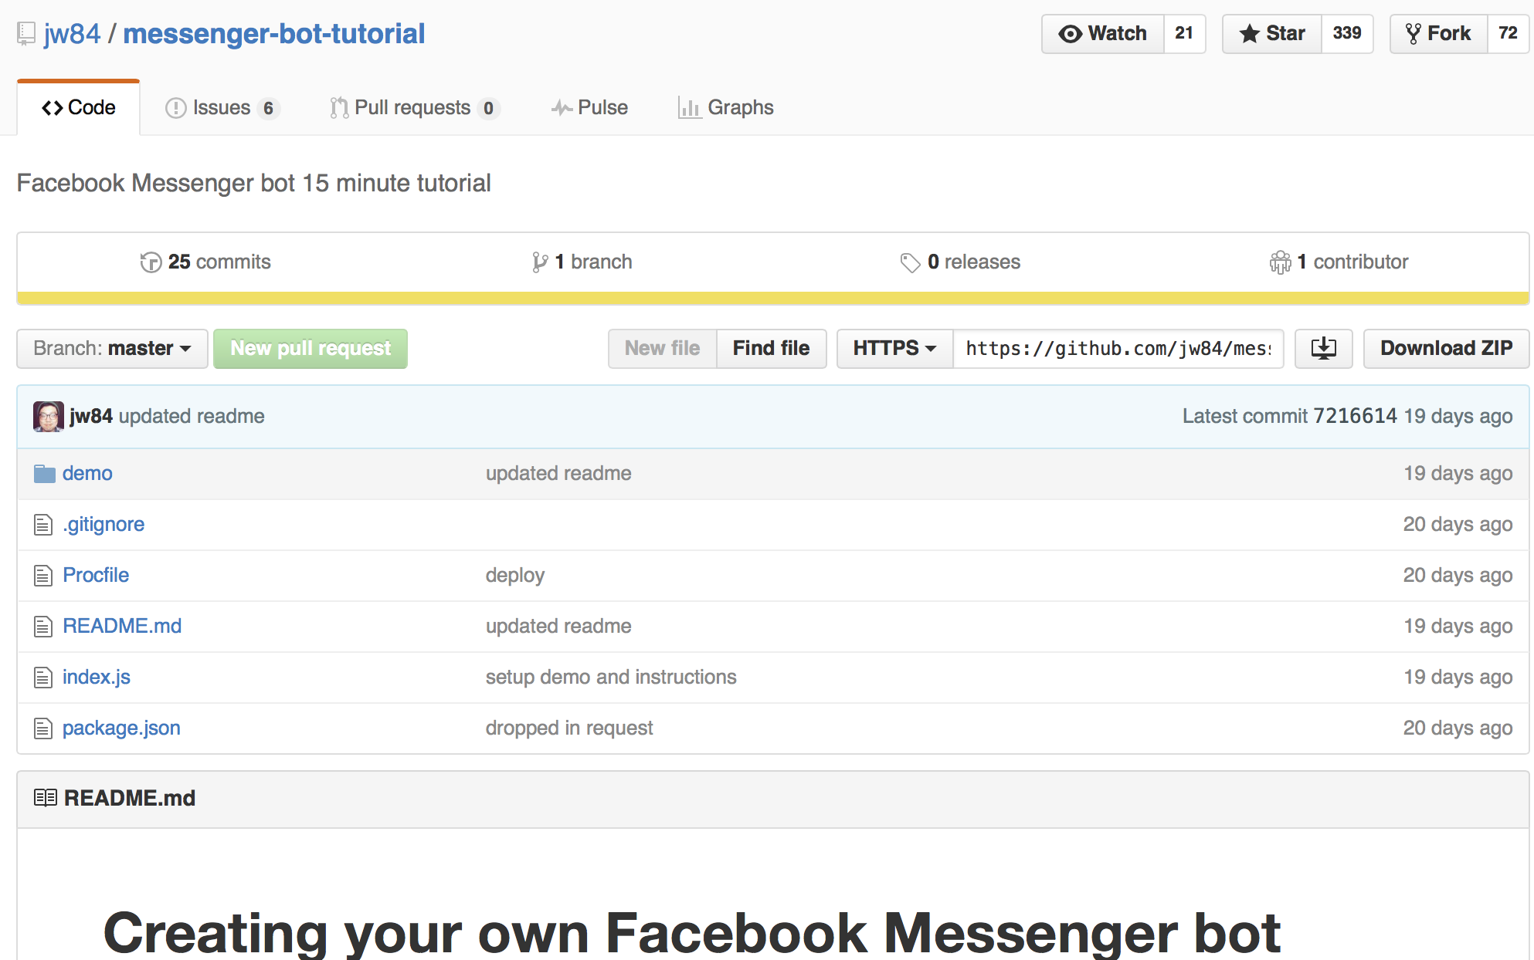


Github
Javascript
Node.js
Heroku
Notes:
Github readme – complete with pictures and files that you can use as templates.
Building a server – with Node and Heroku.
Use Node.js It is open source and allows for the development of server-side Web applications. It runs in the shell. It looks like Flask.
Create a javascript index file (akin to a server.py file); be warned that the syntax he uses for JavaScript does not make sublime happy, so you will want to make changes. It basically tells the server what to do.
Require – us with node.js to load modules (similar to import in python)
Express is a collection that makes it easier to create a web server in node.
bodyParser parses text
Request module makes it easier to make http calls, e.g. get and post method
Set the port to 5000
Sets up an index route
Sets up a route for facebook verification (see it in the next step)
The next thing I want to point out is the route for using the post method
this is a webhook – e.g. it will post a message to a URL when certain things happen; here it will post the bots message, which for this bot is an echo, e.g. it will just stay back what you said to it.
Then the function that actually sends the text messages.
Deploy with Heroku, cloud based development platform that allows you to develop and deploy an app. Thankfully, Heroku works just like git, so it will look familiar and you run it in the terminal window. Git commit and then create a new Heroku instance and push it to Heroku.

Slide 10
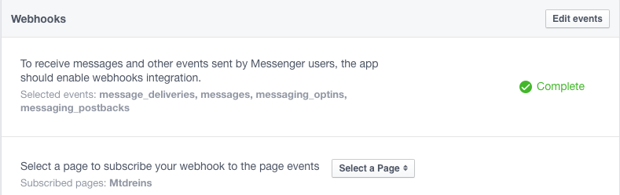
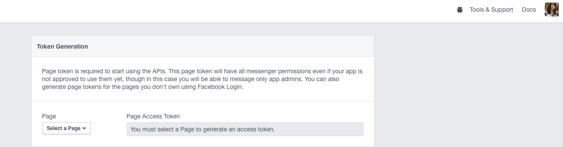
Setup a Facebook chatbot (cont’d)
Notes:
- First, I had to register as a Facebook developer and accept their terms of service.
- Then:
Create a Facebook app or a page – I set up a page
Give Facebook the information about your webhook
Get an access token for your Facebook page – there is a really easy interface for this; you will want to keep this private the same way we did for the Twitter bot.
Use the curl command (MAC) to start the app and enable sending messages.
curl -X POST "https://graph.facebook.com/v2.6/me/subscribed_apps?access_token=<PAGE_ACCESS_TOKEN>"

Slide 11
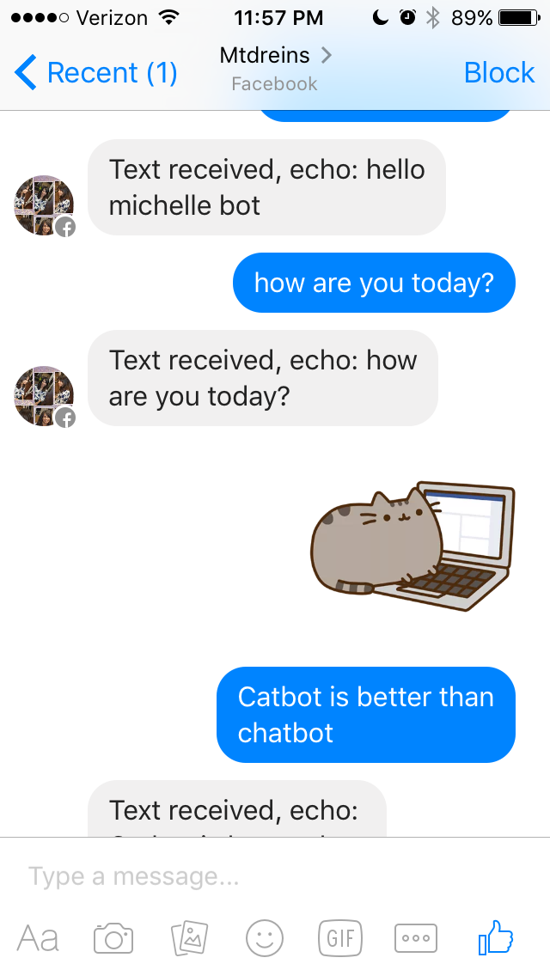
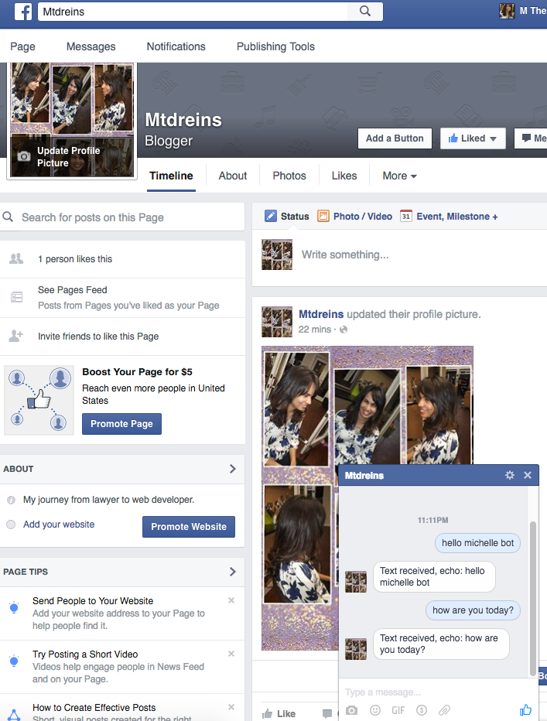
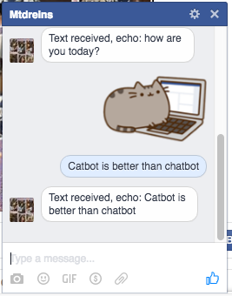
Chat away with your chatbot…
Notes:
Commit the code again and then push it to Heroku.
Go to your facebook page and start chatting! It will echo back messages both on your facebook page and in the messenger app. I am showing pictures of both.
NOTE: FACEBOOK MUST APPROVE A CHATBOT BEFORE YOU CAN RELEASE IT TO THE PUBLIC; WITHOUT THEIR APPROVAL, ONLY ADMINS AND A FEW SELECT OTHERS CAN SEE/USE YOUR CHATBOT.

Slide 12
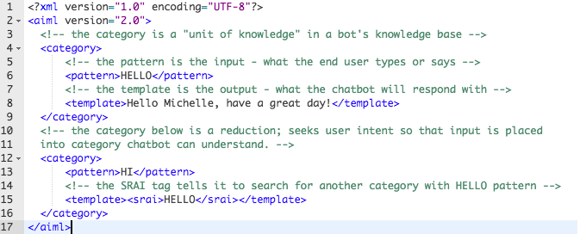
pandorabots.com
AIML = Artificial Intelligence Markup Language
Notes:
Pandorabots is a web service for building and deploying chatbots – IT IS IN BETA.
It is an IDE (Integrated Development Environment).
So you can write the AIML for your chatbot in an on screen editor. Then, you can test it out (they refer to this as ‘training’), which is akin to using a python interactive terminal, to see how it will respond.
AIML (Artifical Intelligence Markup Language – open standard for customizing an ALICEbot (more about that soon).
It is an XML compliant language. XML (Extensible Markup Language) is a markup language that defines a set of rules for encoding documents in a format that is readable by machines and humans)
AIML looks a lot like html. READ COMMENTS PUT INTO CODE
There is something called the UDC (Ultimate Default Category) which is a fallback response when the chatbot cannot match any pattern. The UDC is another AIML file and it can be edited. Pandorabots comes with a default, that just states “I have no answer for that.”

Slide 13
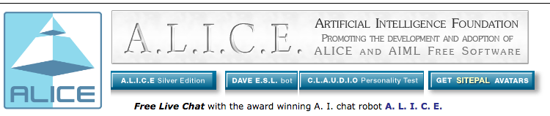

ALICE & ROSIE
Notes:
Artifical Intelligence Foundation promotes AIML, and also the free A.L.I.C.E. AIML, which is a knowledge base of 41,000 categories. Remember, a category is a unit of knowledge. You can download it from Google Code.
Pandorabots has ROSIE, which is a version of ALICE optimized for their site. (think Jetsons)
PANDORABOTS has a RESTful API (I believe we are going to learn more about that in this afternoon’s lecture too - everything that you need is in the request) that will let you integrate the chabot you build on their site into various messaging applications (Slack, Twitter, Hubot, Facebook, Skype, Twilio, and more) – for a fee. Based upon the number of bots that you have and the number of interactions you will have each month.
ALSO NOTE: Again, you can create a chatbot with Javascipt or AIML; there are other services and languages.

Slide 14
Additional Resources
Links:
https://www.chatbots.org/ - List of “all” chatbots in the World
http://www.alicebot.org/ - Artificial Intelligence Foundation
https://github.com/jw84/messenger-bot-tutorial - Facebook bots
https://developers.facebook.com/docs/messenger-platform/quickstart - Facebook docs for their chatbots
http://www.pandorabots.com/ web service IDE for bot development
http://wit.ai - uses Javascipt, Node.js & Wit API for bot development

